Slide 1
Management
PhD in Business Economics
Luis D. Torres, PhD.

Slide 2
Agenda
Bonus: Building a publishing strategy

Slide 3
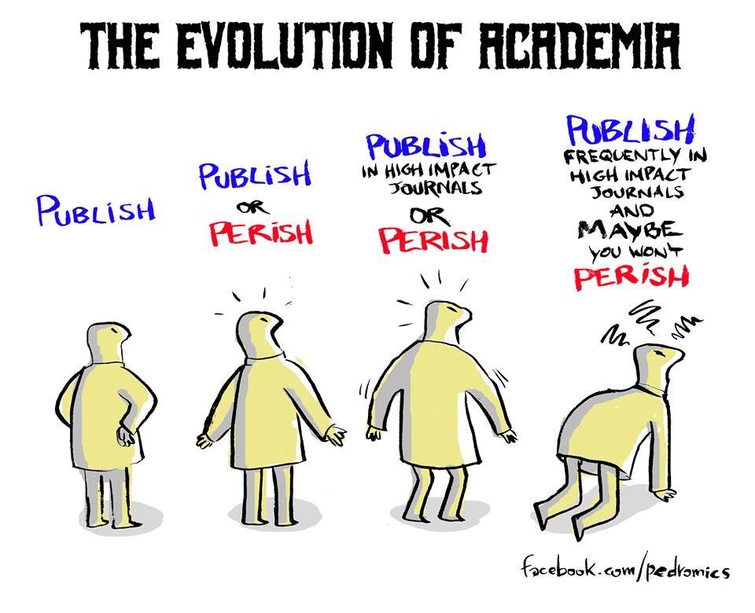

Slide 4
What are the chances of publication in top journals?
Desk rejects = 70%
Acceptance rates = 5% (or lower)
Revise and resubmit is probably the best you can hope for
Reasons for rejection: fit with journal; nature of contribution; rigour of methods; novelty of contribution; theoretically weak …
Revise and resubmit – all of the above …
In the final analysis the main reasons for rejection are:
Lack of contribution
Failure to develop theoretical contribution
Fatal flaws in methodology
Deficiencies in the analysis
Lacks interest

Slide 5
You need to stimulate interest
Why is this topic and your contribution worth considering for journal space?
What does it add to current debates?
What does it add beyond replication of existing research?
If it is a methodological paper, does it make a significant methodological contribution?
If it is a theory paper, what does it add to the conversation in this field of study?
Emphasise strength of contribution and weaknesses
When you start reviewing you will see that many papers are not very stimulating!

Slide 6
The key element is contribution
Contribution = Rigour + Relevance
Contribution to scholarship
Contribution to practice
Impact is growing in importance. We will study this next class.

Slide 7
Assessing your contribution
Focus your area of interest
Study the history of the conversations in your area of interest (literature review)
Select 3-5 exemplary contributions to that debate
Who are the main scholars in the area? What are their most important journal papers
How is what you propose relevant to these papers?
What do you want to add to the conversation?
Why will other scholars be interested in what you want to add?
Why will journal editors want to publish you?
You need to justify your research in relation to the state of knowledge in your field, as represented in key journals by key authors.

Slide 8
How high should you aim?
Where to send it? Management, economics etc.? General or focused journals e.g. CSR paper – send to AMR or JBE?
Make sure your submission aligns with journal editorial policy
Cite papers from the journal to demonstrate your engagement with lines of inquiry relevant to the journal
If appropriate, choose relevant editor with appropriate interests, and referee(s)
Proofread your paper to optimise professional presentation
Share/present the paper before submission to get feedback on strengths & weaknesses

Slide 9
Submitting
Framing the paper is crucial - Explain your contribution & added value
Explain theoretical and empirical contribution
Do not mischaracterise the literature
Drawing a model might help
Link your hypotheses to your theory and delimit variables you are dealing with
Ensure methods and measures are fully explained and appropriate
Ensure your data is robust and adequate for the journal (e.g. interview numbers, sampling, sample size …)
Conduct detailed discussion of the findings, implications and limitations
Give the paper a lift at the end – emphasize contribution, don’t finish on limitations, but don’t over-claim (appropriate humility!)
So…Say what you are going to say, Say it, Say what you have said, Discuss the significance of what you have said

Slide 10
Cultivate patience
Initial decision – 4-6 months
Resubmission – 3-6 months (depending on the decision) – top journals can require hug amounts of work (conceptual, theoretical, data gathering) – you might receive 10-15 pages of reviewers’ comments
If R&R then you have passed the threshold test but eventual publication is far from guaranteed
You may need 2 or even 3 revisions. It can take years!
Acceptance! – Publication in 6-12 months (electronic publication sooner)
Most papers get rejected – even by top scholars
If you’re not getting rejected, you are not aiming high enough

Slide 11
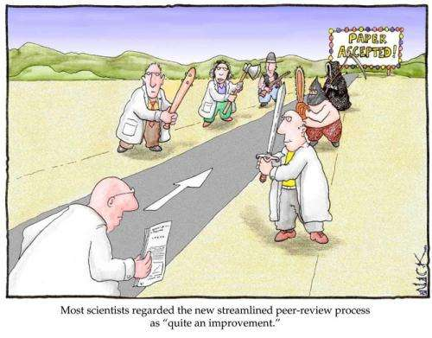
Publication in top journals is tough!

Slide 12
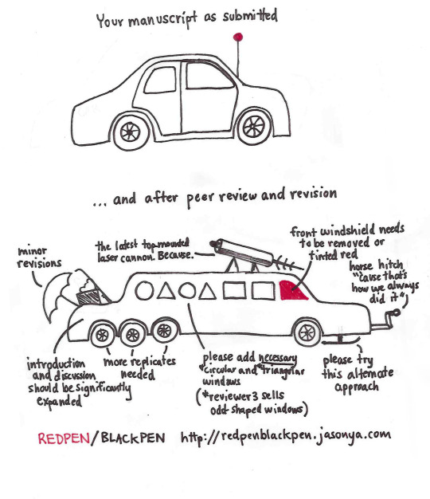
Revise and resubmit - How it feels to an author

Slide 13
Rejection?
Blame the reviewers for their lack of insight (even if unanimous rejection!)
Be rational – remember this is the most likely decision.
DO NOT CHALLENGE THE DECISION. Editors are very very very unlikely to overturn a decision. They do not want to alienate reviewers.
Try and not take it personally. It is an impersonal decision and probably contains at least some elements of truth
Move on
Take feedback on board as appropriate
This is a judgment call so consult with more experienced authors. Reviewers often disagree and the reviewers for another journal might have a different opinion
Submit elsewhere as appropriate
If it is rejected again, go back to the drawing board

Slide 14
Develop a research pipeline
Papers that count are at a premium
Develop a portfolio of publications
Choose the journal in discussion with supervisors and peers
Networking to enhance productivity
International collaboration highly recommended
Go beyond the closed loop of academic literature to identify gaps and new areas
Need to link to existing literature to show novel insight

Slide 15
Additional resources
Publishing Original Research in AMJ: Advice to Prospective Authors | Academy of Management Journal
What Makes Management Research Interesting, and Why Does It Matter? on JSTOR
Having Scholarly Impact: The Art of Hitting Academic Home Runs on JSTOR

